Slide 1
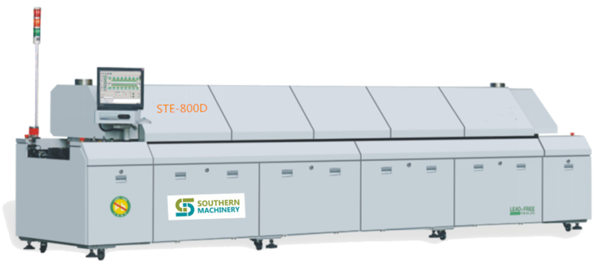
STE-800D Hot air lead-free reflow oven machine

Slide 2
STE-800D Hot air lead-free reflow oven machine brief introduction:
Machine Specification
Model | STE-800D | Control | Industrial computer
Heating zones quan. | Top 8,bottom 8 | Cooling zones quan. | Top 2
Heating zone length | 3110mm | Current plate structure | Galvanized plate
Weigth | APPROX:2400KG | Dimension | 5310*1430*1530mm
Exhaust capacity | 11㎡/min×2 | Color | Grey
Control system
Electricity supply | 3P 380V/220V 50/60HZ | Temp. control range | Room temp.～300℃
Total power | 67KW | Temp. control accuracy | ±1℃（statical state）
Start power | 32KW | Temp. control method | PID +SSR drive
Consumption power | 10KW | PCB temperature deviation | ±1.5℃
Speed control | 3 Inverters adjust | Data save | All profiles can be saved
Warm up time | Apprx.30minute | Abnormal alarm | High, low temp. alarm
Conveying system
Rail structure | 2 sectional rails | Rail fixed method | Front fix
Chainstructure | Stuck-free type | Conveying height | 900±20mm
PCB Max. width | 50-500mm(at the same time50-250mm | Conveying method | Mesh+ chain
Component height | Top/bottom 25mm | Conveying speed | 300-1500mm
Conveying direction | Left to right(right to Left) | Lubrication | Automatically or manually
Cooling system
Cooling method | External water chiller
Heating features
Heating zones | Top 8,bottom 8（3110mm）can meet the need of the peak lead-free technique.
Cooling zones | After cool down by water chiller, PCB temp. is ≤70℃ at the exit.
Warm up time | From the normal temp. to set temp, approximate 30 minutes.
Warm up sequence | Warm up from two side, save the power and time
Profile transfer time | ＜15min
Heating zone temp. control accuracy | ±1℃
PCB temp. deviation | ±1℃
Empty→ full load heat balance respond time | ≤20 s
Heating zones separately close funtion | Every heating zone can be closed separately on computer. When the bottom heating zones are closed, the PCB two sides temp. different reaches max.( PCB of different material, thickness, size, the temp. difference value is different.)

Slide 3
Heating parts
Hot air motor | Import anti high temperature motor,RPM:2800rpm。Adopts inverter to control, can adjust the speed of motor from 0to 3000, stepless. Motor warranty is 5 years.
Heater | The heater is specially made, with high efficiency and sensitivity, warranty time is 5 years.
Air lane structure | High efficient air lane, provides abundant air
Exhaust system | Forced exhaust device, ensure no escape of flux.
Transmission parts
Anti torque rail | High strength and hardened rail, is very durable and wear resistant.
Rail parallelism | ±0.3mm
Chain stretch out length | Standard: 5mm, the chain is anti stuck type, solve the soldering problem of small PCB
C/V speed set min.unit range | 0.01m/min, 0~2m/min
C/V speed deviation range | Computer close loop, within ±2%
Chain tension device | Automatic adjust by spring, avoid the chain stuck due to the heating.
Conveying motor | Panasonic adjustable motor
Chain lubrication | The lubrication is controlled by PC, lubrication cycle and time can be set（there are three modes: fine, standard, economical. There is also manual lubrication in software）
Rail width-adjusting | Independent adjusting
Mesh | 500mmstainless steel mesh，runs synchronized with chain
Transport rail fixing method | Front and rear rails fixed, central rails moveable
Dual rail transport | D for dual rails, 1, 3 or 1, 4 fixed, can pass the maximum PCB size of 250x250mm at the same time

Slide 4
Machine structure
Frame | The frame is well soldered, firm and durable.
Door | Dismountable structure, provide wide space for maintenance.
Hood open method | Double electric cylinder to open the hood, with self-lock function, safe and reliable.
Cover open method | Self-made holder, easy to clean up
Electrical parts and control performance
Control system | Industrial PC | PLC+Modular＋PID, stable and reliable, with high repeat accuracy
Operation interface | Windows7 with Chinese& English shift easily.
Machine&operator safety | With creepage protector
Electric part | All electric parts are imported, very durable, ensure the machine runs stably.
Working mode | Three working mode: operation, edition and presentation, with on-line editing function
Real time monitor | Generate the operation record daily, if there happens some problems, the responsible operator will be found easily.
Temperature profile | Generate the profile for each zone daily, user can review and analyze. This function is not for PCB profile testing, just for inspecting when some problem happens in a certain zone.
Production database | Generate production statement for all kinds of PCB and statistics, printable.
Alarm list | The system saves all alarm information for user to review the alarm item and time.
Alarm system | The system enters cool down mode when the alarm is strict.
Profile test | With temp. profile testing function, can analyze according to the profile.
Abnormal alarm | 1.PCB runs abnormally 2.operation abnormal 3.temperature abnormal 4.conveyor speed abnormal 5.hot air devices abnormal.
Flux recycle device | Standard configured. When use nitrogen, as it is closed recirculation, if the flux fog can not be spread, it will pollute the PCB.

Slide 5
STE-800D Hot air lead-free reflow oven machine
Excellent welding quality
Top thermal engineering performance
High efficiency and stable productivity
Minimum operating energy consumption
The control system of artificial intelligence

Slide 6
Top thermal engineering performance
An excellent reflow soldering product should meet the following standards:
Minimum blast temperature deviation of furnace chamber section
Minimum PCB solder spot temperature deviation
Higher heating efficiency
Faster thermal compensation capability
STE-800D Hot air lead-free reflow welding will bring you a new performance experience!

Slide 7
Top thermal engineering performance
minimum air temperature deviation in furnace section:
1. Get the actual temperature closer to the set temperature
2. More uniform temperature uniformity of furnace chamber can be obtained
STE-800D product and other excellent product wind temperature comparison
(according to the industry standard)
The serial number | Test project | Other excellent products | STE-800D
1 | The set value deviates from the actual value | +1/-3℃ | ±1℃
2 | Peak temperature deviation of wind temperature at 7 o 'clock | ≤1.5℃ | ≤1.0℃

Slide 8
Top thermal engineering performance
Minimum PCB solder spot temperature deviation:
1. Prevent uneven heating of components with different sizes on the PCB board,
cold welding or over-welding
2. Easy to obtain consistent welding quality
PCB temperature comparison between STE-800D product and other excellent products (according to industry standard)
The serial number | Test project | Other excellent products | STE-800D
1 | The set value deviates from the actual value | 250℃/≥230℃ | 250℃/≥235℃
2 | Peak temperature deviation at 4 | ≤5-8℃ | ≤±1.5℃

Slide 9
Top thermal engineering performance
Higher heating efficiency
What is thermal efficiency:
The extent to which the heat provided by the furnace is effectively utilized, that is,
the percentage of the total heat absorbed by the heating element.
Higher thermal efficiency:
1. The more heat the components absorb
2. The higher the thermal utilization rate of the equipment is
Comparison of thermal efficiency of STE-800D products with other excellent products (according to industry standards)
The serial number | Test project | Other excellent products | STE-800D
1 | Single point thermal efficiency (deviation between set temperature and actual temperature) | 300℃/≥220℃ | 300℃/≥235℃
2 | Multipoint thermal efficiency (peak temperature deviation at 7 points) | ≤7℃ | ≤4℃

Slide 10
Top thermal engineering performance
Faster thermal compensation capability
1. Significance of rapid thermal compensation capability:
2. To ensure that the furnace temperature still meets the production process
requirements in the continuous mass production process
Comparison of thermal compensation capability between STE-800D product and other excellent products (according to industry standard)
The serial number | Test project | Other excellent products | STE-800D
1 | Peak temperature deviation(no load and load data comparison) | ≤3-5℃ | ≤1.5℃ (latest figures)

Slide 11
Performance characteristics of reflow welder are introduced
Double corner fan cover, adequate hot air infiltration air volume, more even air, higher heating efficiency, temperature difference can reach ±1℃ or so.
Upper and lower independent heating modules, independent hot air circulation, the temperature difference between adjacent temperature zones can be drawn to about 100℃, double welding zone set;Temperature zone independent wind speed control, so that the process adjustment range is wider, easy to cope with all kinds of complex lead-free welding process.
Drawer type heating wire and hot air motor structure, convenient and fast maintenance, 15 minutes to complete the replacement work.
The rectifying plate adopts 8MM thick aviation high-pressure aluminum plate imported from the United States with original packaging, which has strong heat storage capacity and strong heat radiation ability. It enables the components to be heated by hot air infiltration and heat radiation infiltration at the same time, effectively reducing the influence of small circulation heating wind Angle shadow, greatly improving the welding quality of components and reducing the power consumption of equipment.
Exhaust system layout is more reasonable, the whole process of rosin recovery device makes the rosin treatment effect more thorough, avoid the occurrence of rosin accumulation and pollution products in the furnace, and the cleaning cycle is extended twice.
Air volume in the cooling zone can be adjusted to avoid too high or too low cooling slope affecting the welding quality and improve the welding quality of PCB
The whole process of each temperature zone has a temperature patrol to monitor the temperature change at all times, which better ensures the stability of welding temperature.
The transportation adopts American AB frequency converter stepless speed regulation, and it is equipped with American santer UPS uninterruptible power supply and hand-shaking function, which can effectively prevent PCB from burning out in the furnace due to power failure.Guide rail with my company's independent design of special aluminum profile, superhardening treatment, no deformation.The structure adopts 2 sections of indenting extension type. After heating, the guide extends inward after thermal expansion.Avoid the occurrence of PCB board dropping due to deformation of guide rail, size head and fish belly.

Slide 12
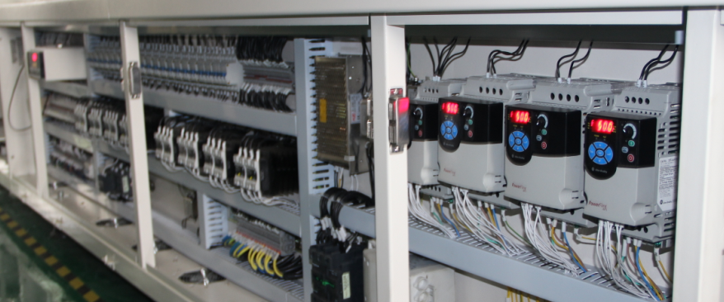
The electronic control performance of the product is guaranteed
The electrical control box of each machine has been elaborately made, with the most excellent international brand, through strict testing, striving to achieve the best quality
The electrical control system of the international CE standard and the control system of the neat standard are one of the reference points to check whether a equipment is qualified.

Slide 13
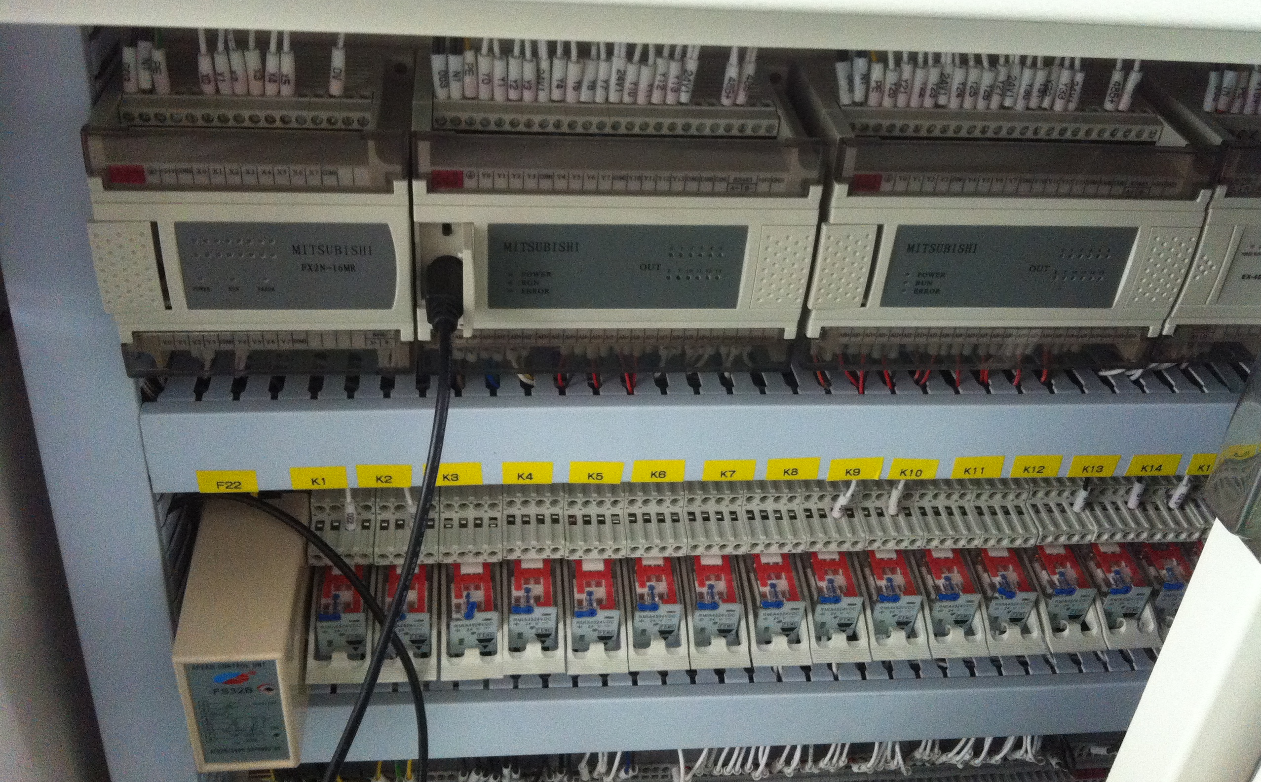
PLC control module
The whole machine control system adopts Japanese mitsubishi PLC for control, temperature control mode adopts full closed-loop PID control mode, the control accuracy error value is within 1℃.
-- PLC is a programmable logic controller, which adopts a kind of programmable memory, used for its internal storage program, to execute logic operation, sequence control, timing, counting and arithmetic operation and other user-oriented instructions, and control various types of machinery or production process through digital or analog input/output.

Slide 14
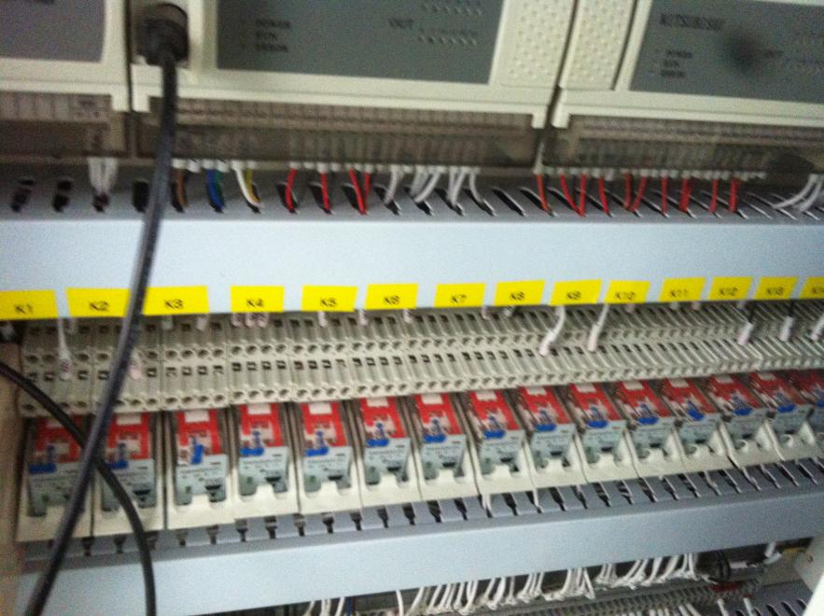
Intermediate relay
Intermediate relay, from Swiss jiale, with high quality and stable performance, can ensure the stable operation of the control system and the normal operation of the machine.

Slide 15
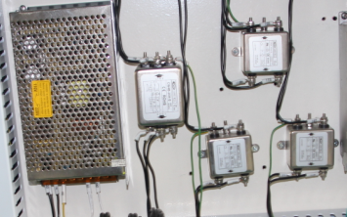
Switching power supply plus filter
In the power supply, not only use the best quality switching power supply, but also in each power add a high-strength filter, so that all interference can not affect the performance of the equipment
Inlet filter
The power filter can separate the interference signal from the useful signal, improve the anti-interference and signal-to-noise ratio of the signal, and improve the analysis accuracy.To protect the electrical control system from interference current and voltage.
----Switching power supply is a kind of power supply that USES modern power electronic technology to control the time ratio of switching tube on and off and maintain stable output voltage.
High stability switching power supply

Slide 16
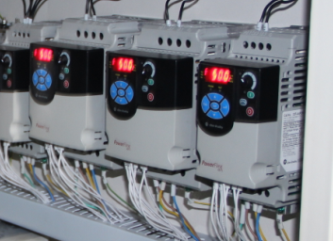
Inverter stability
transportation, air, cooling system are adopted AB inverter, stepless speed regulation, so that your welding speed, hot air, cooling speed can be selected to the best state.
The American AB variation is more stable
AB inverter is an industrial control terminal manufactured by rockwell automation, USA. AB inverter is manufactured according to European CE standard and Chinese CCIB standard
- frequency converter
The inverter is mainly composed of rectifying (ac to dc), filtering, rectifying again (dc to ac), braking unit, driving unit, microprocessing unit and so on.
How it works: change the speed of the motor by changing the output frequency.

Slide 17
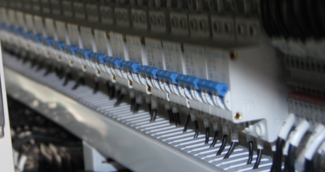
Overcurrent protection air switch
We add an overcurrent protection switch above each heating zone to automatically cut off the power supply when the heater fails, thus protecting the fault from spreading.Of course our best hope is that he doesn't provide protection that hasn't worked.
Inlet overcurrent protection switch
----Air switch in the low-voltage control circuit, the air switch is the circuit breaker (must be separated in the high-voltage distribution), in the circuit for switching on, breaking and carrying the rated working current, and can be in heating and motor overload, short circuit, undervoltage in the case of reliable protection.The dynamic and static contact and contact bar of the circuit breaker are designed in parallel, and the electric repulsion force generated by the short circuit is used to make the dynamic and static contact disconnect, with high breaking capacity and strong current limiting characteristics.

Slide 18
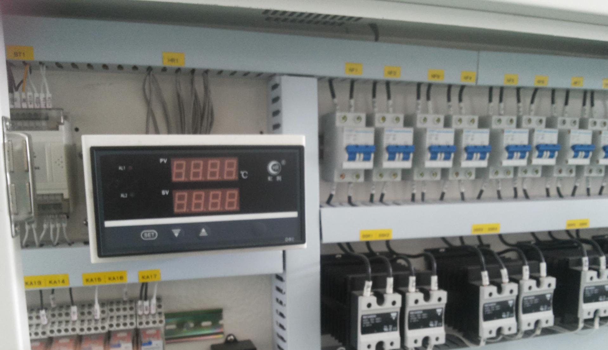
Temperature patrol instrument
We also installed a temperature patrol on each machine to monitor the temperature of each temperature zone at all times, so that the temperature of each temperature zone is within the normal range, beyond the set temperature range immediately alarm.
The temperature patrol produced by Shanghai hongrun precision instrument, the first brand in China, with real artificial intelligence calculation, no need for manual adjustment of parameters, temperature control precision up to ±0.1℃, able to monitor the control temperature of each temperature zone, and further improve the quality of PCB components.

Slide 19
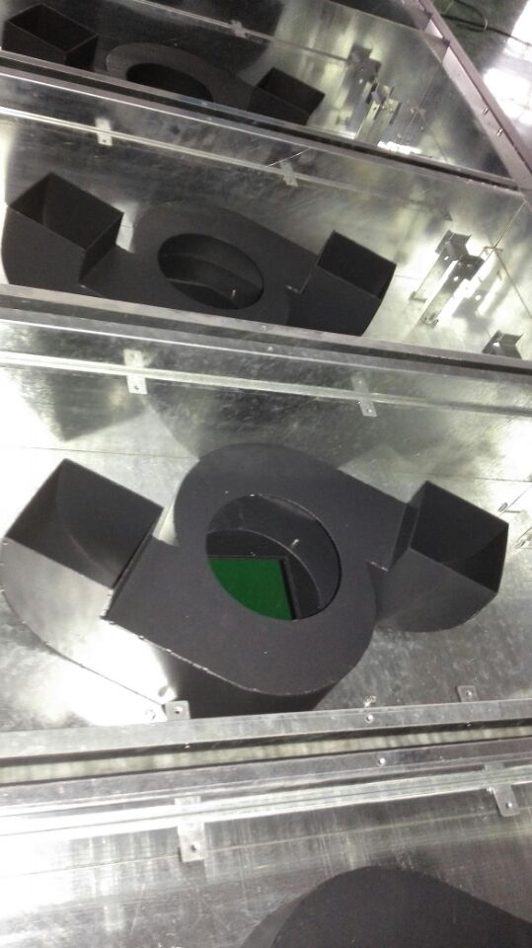
Double Angle fan cover function
Double Angle fan cover is our company's patent technology
The double corner fan cover structure can effectively divide the air in the flow passage for the first time, which can reduce the temperature difference control precision of reflow welding at 3 points by 1℃ immediately on the basis of the single corner fan

Slide 20
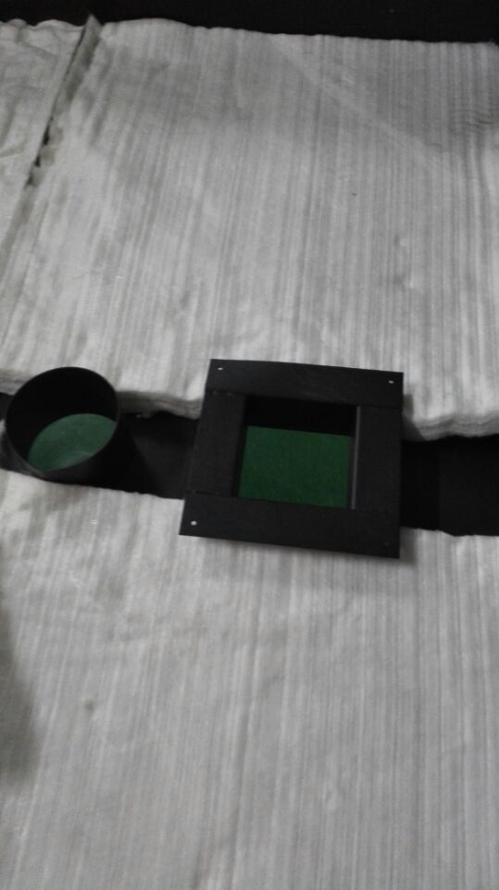
Heat insulation cotton in furnace
The intermediate heat shield of the liner is made of American high quality sisal heat insulation cotton, which effectively increases the thermal conductivity resistance by 3 times, and the reflow welding surface temperature does not exceed 30 ° c
Low-end equipment is glass fiber cotton, poor insulation, quickly aging, insulation more and more poor, and harmful to human health.

Slide 21
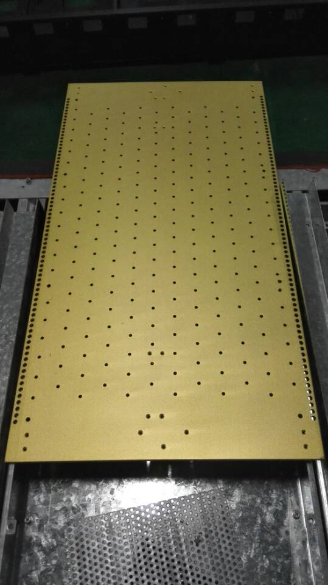
Rectifying plate moving structure
Rectifying plate adopts the imported from 10 mm thick (JT10MM) aviation aluminum alloy material, high temperature after hardening treatment, precision CNC machining, punching, polishing, make each hole location error value within 0.02 mm, its material itself has excellent effect on the heat storage, thermal radiation ability, make components get hot air permeability and thermal radiation penetration at the same time two heating mode, effectively reduce the influence of pulmonary circulation heating cape wind shadow, greatly improve the welding quality components, and reduce the power consumption equipment.

Slide 22
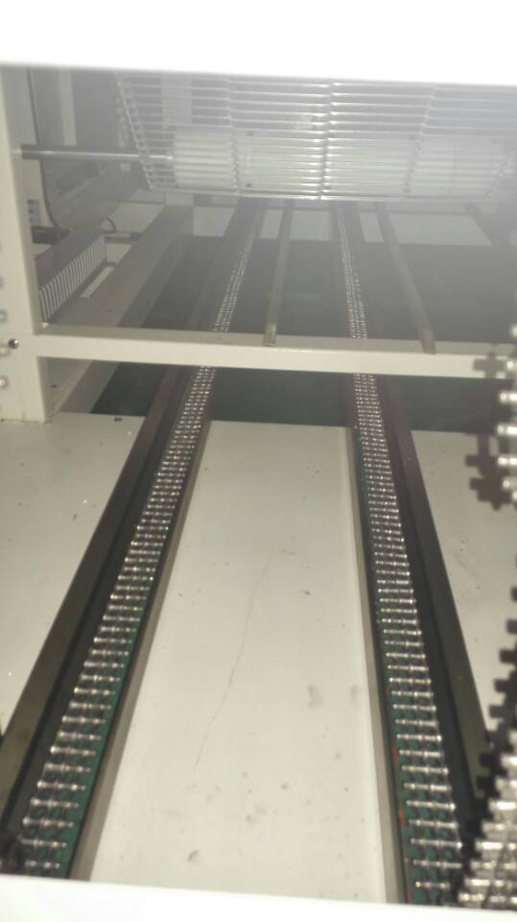
Chain loop construction
The chain loop adopts special guide rail for the loop to avoid chain jitter and displacement of components during welding

Slide 23
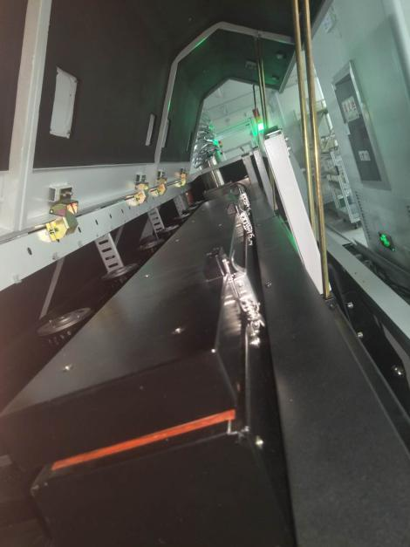
Rosin recovery system
The inlet and outlet of the equipment and each temperature zone are equipped with rosin recovery system, you will never have to worry about rosin pollution of your products and furnace bile cleaning!
Unified waste gas recovery pipeline;During the welding process, each temperature zone has a different effect on the solder paste, thus the residual gas is also different, and in each welding zone there is a recovery pipe, the exhaust gas is uniformly recovered and discharged into the outdoor.

Slide 24
Efficient production capacity
Capacity -- the key factor that decides production cost!
Factors affecting productivity:
1. Production chain speed of equipment
2. Operation stability of the equipment (including electrical control and mechanical structure)
3. Equipment maintenance cycle
STE-800D series products, is a truly efficient, high-speed, stable, easy to maintain reflow welding equipment

Slide 25
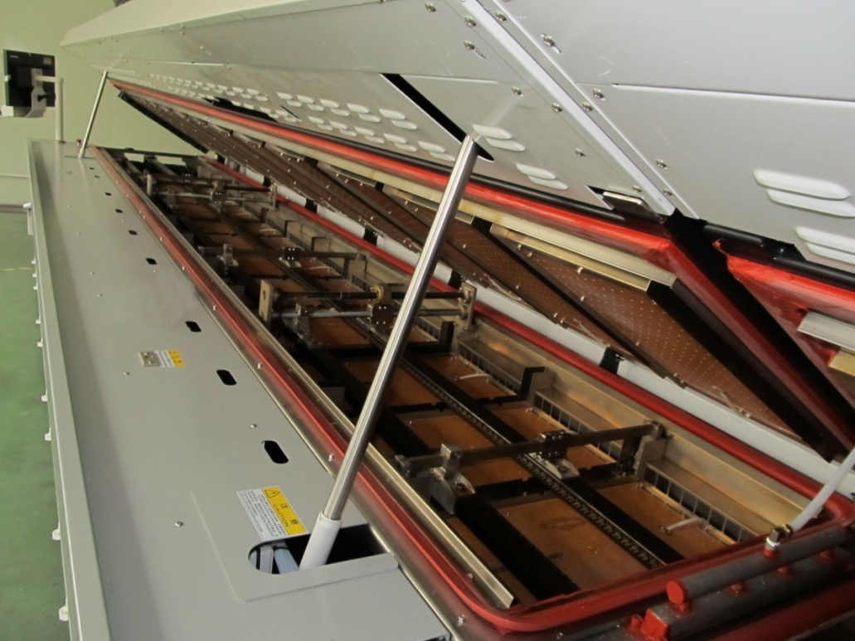
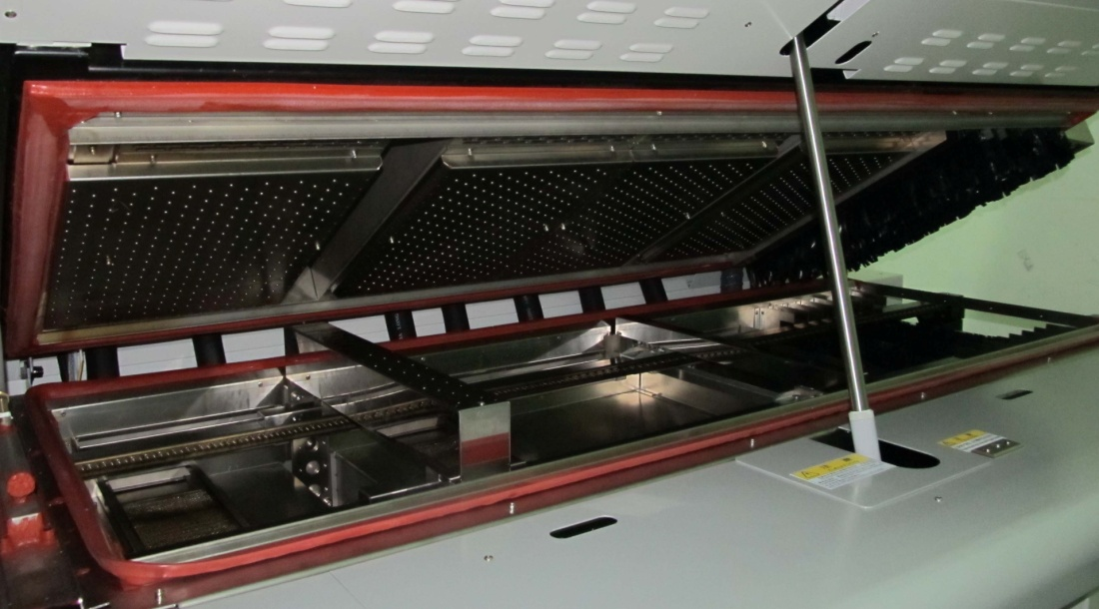
Efficient production capacity
At present, reflow welding equipment production chain speed is limited within 100cm/min for all manufacturers
Maximum heating zone :12
Maximum heating length :4305mm
Fastest chain speed: 160cm/min
Standard 3 cooling zones
Effective cooling length :1397mm
Guarantee the cooling effect of high speed production

Slide 26
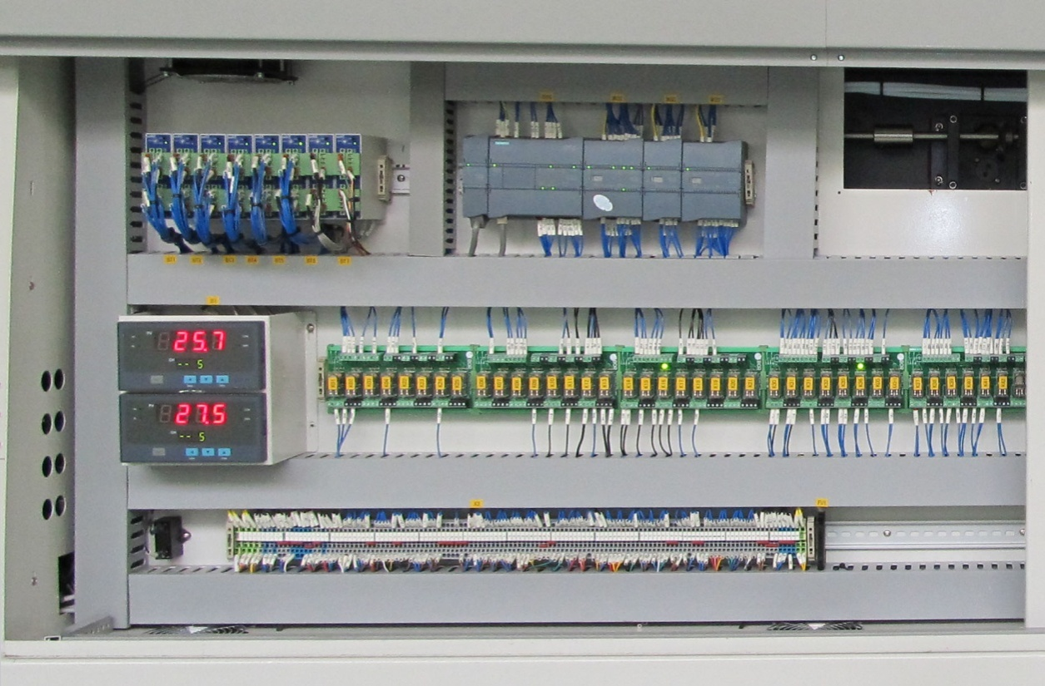
Efficient production capacity
Mitsubishi PLC control system, stable and reliable
Whether the operation of the equipment is stable and reliable,
Decided whether the equipment can continue to produce benefits!
Mitsubishi temperature control module, with self - tuning function, high repeat accuracy of temperature control

Slide 27
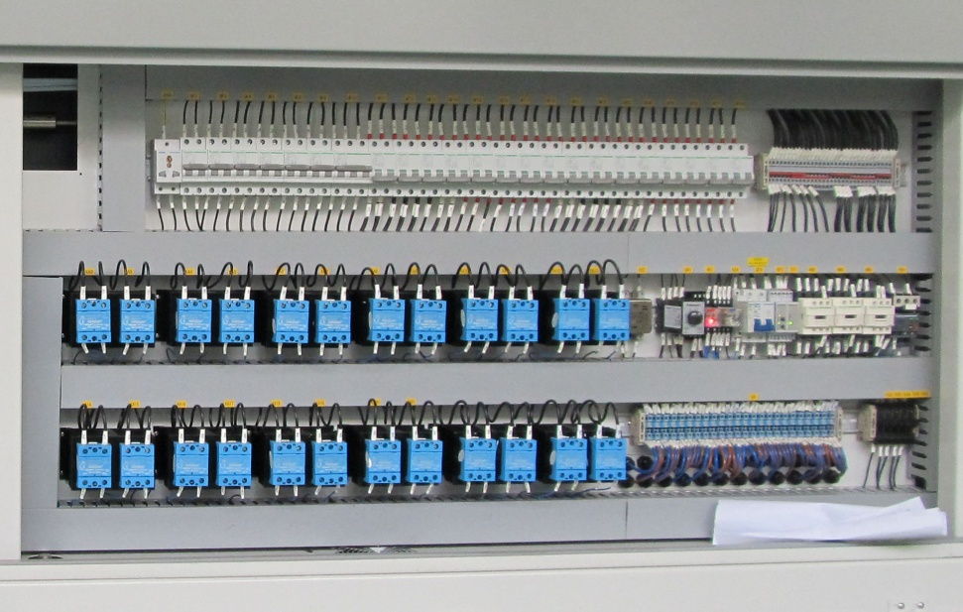
Efficient production capacity
PID control +SSR drive, accurate temperature control
Each temperature zone is protected by independent inspection of temperature

Slide 28
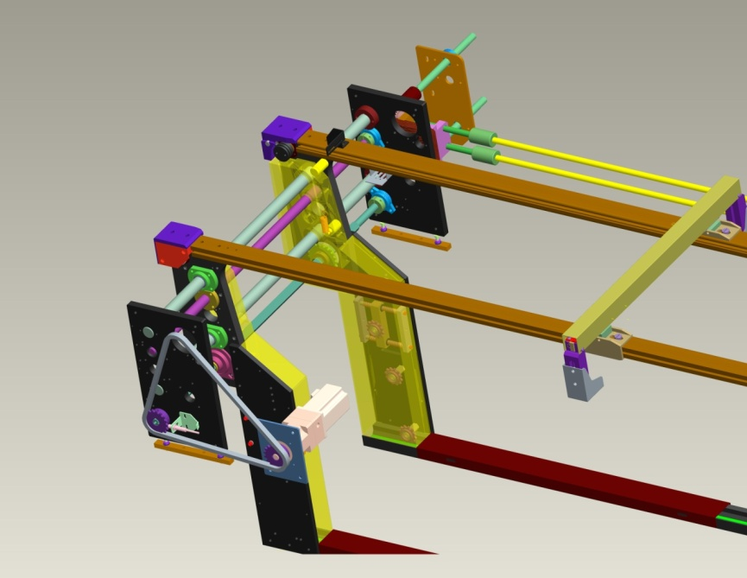
Efficient production capacity
Transportation guide hardened treatment, improve the service life of guide
5 sets of synchronous width adjustment design, to ensure long-term stable rail transportation
Transport chain cover, prevent foreign body from entering, avoid transport vibration, even stuck

Slide 29
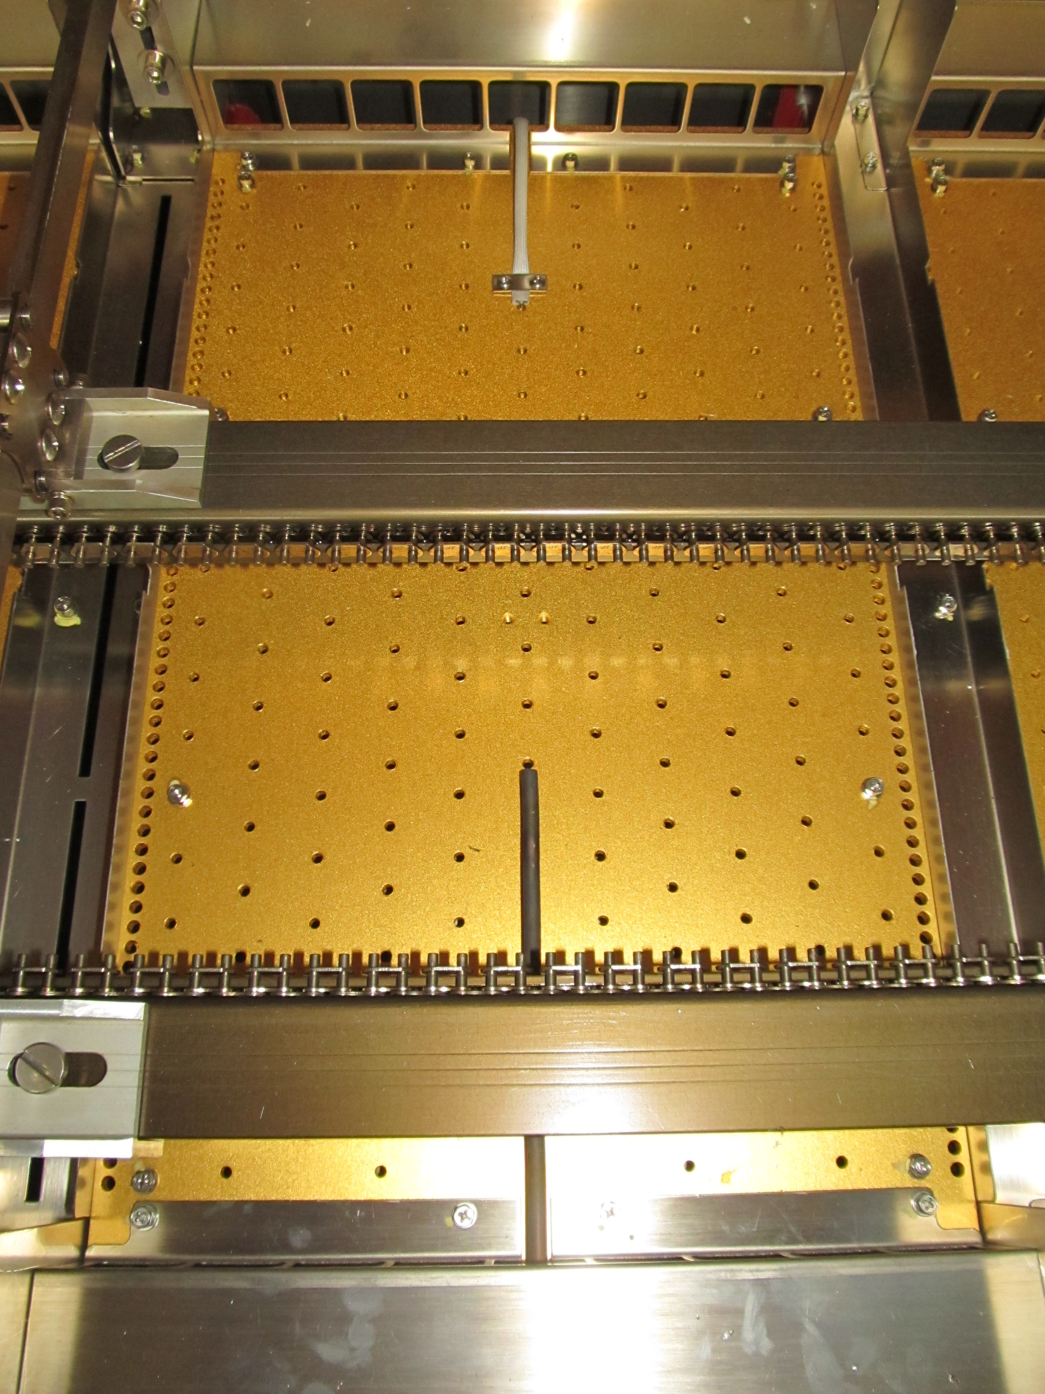
Efficient production capacity
The draft design under flux avoids the problem of drip dirty plate caused by traditional draft design.

Slide 30
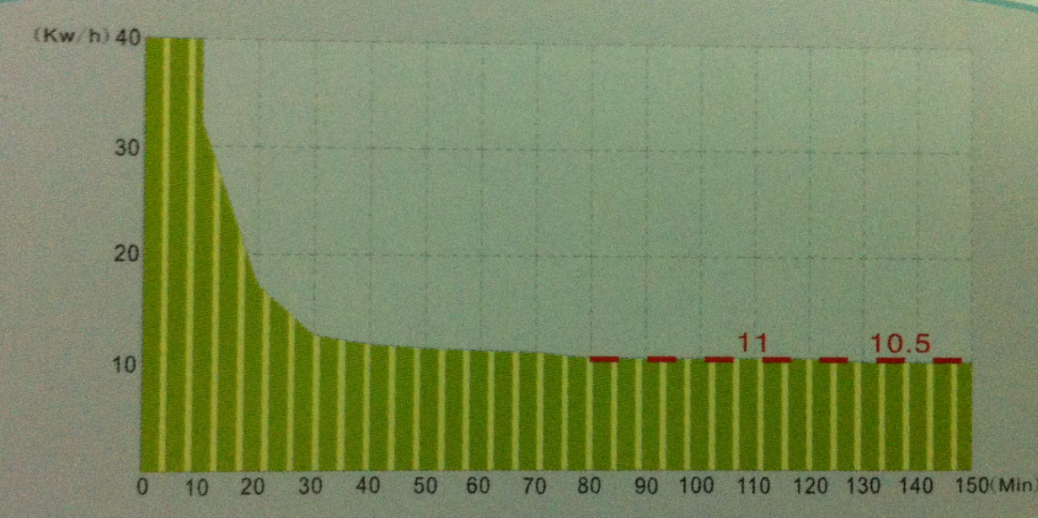
Minimum operating energy consumption
Power consumption is the main operating cost of the equipment!
The factors that determine power consumption:
1. Electrical and thermal conversion efficiency
2. Heating efficiency of equipment
3. Heat dissipation of furnace body
4, flux recovery heat loss
5. Production saturation
Low power consumption, compared to similar products on the market to save electricity 20%

Slide 31
Welcome inquiry
1,Please visit : www.smthelp.com
2, Find us more: https://www.facebook.com/autoinsertion
3, Know more our team: https://cn.linkedin.com/in/smtsupplier
4, Welcome to our factory in Shenzhen China
5, See more machine working video, please Youtube: Auto Insertion
6, Google: Auto+insertion, to get more informations
7,Looking forward to your email: Ronin@smthelp.com ,info@smthelp.com

